Slide 1
Software Quality Assurance
Dr. Seemab Latif
Lecture No. 4
13th October, 2010

Slide 2
Review of Previous Lecture
Black box testing is a strategy in which testing is based solely on the requirements and specifications.
It requires no knowledge of the internal paths, structure, or implementation of the software under test (SUT).
It can be applied to all levels of testing.
When using black box testing, the tester can never be sure of how much of the system under test has been tested.
Even though we can't test everything, formal black box testing directs the tester to choose subsets of tests that are both efficient and effective in finding defects.
Techniques of Black Box Testing: Equivalence Class Testing, Boundary Value Testing, Decision Table Testing, Pair-wise Testing, State-Transition Testing, Domain Analysis Testing, Use Case Testing.

Slide 3
White Box Testing
White box testing is a strategy in which testing is based on the internal paths, structure, and implementation of the software under test.
White box testing generally requires detailed programming skills.

Slide 4
White Box Testing Process
The general white box testing process is:
The SUT's implementation is analysed.
Paths through the SUT are identified.
Inputs are chosen to cause the SUT to execute selected paths. This is called path sensitisation. Expected results for those inputs are determined.
The tests are run.
Actual outputs are compared with the expected outputs.
A determination is made as to the proper functioning of the SUT.

Slide 5
Applicability
White box testing can be applied at all levels of system development—unit, integration, system, and acceptance.
Generally white box testing is equated with unit testing performed by developers. While this is correct, it is a narrow view of white box testing.

Slide 6
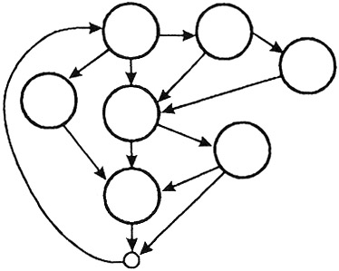
Applicability
White box testing is more than code testing-it is path testing. Generally, the paths that are tested are within a module (unit testing). But we can apply the same techniques to test paths between modules within subsystems, between subsystems within systems, and even between entire systems.

Slide 7
Disadvantage-1
The number of execution paths may be so large than they cannot all be tested. Attempting to test all execution paths through white box testing is generally as infeasible as testing all input data combinations through black box testing.

Slide 8
Disadvantage-2
Second, the test cases chosen may not detect data sensitivity errors. For example:
p=q/r;
may execute correctly except when r=0.
y=2*x // should read y=x²
will pass for test cases x=0, y=0 and x=2, y=4

Slide 9
Disadvantage-3
Third, white box testing assumes the control flow is correct (or very close to correct). Since the tests are based on the existing paths, nonexistent paths cannot be discovered through white box testing.

Slide 10
Disadvantage-4
Fourth, the tester must have the programming skills to understand and evaluate the software under test. Unfortunately, many testers today do not have this background.

Slide 11
Advantages
When using white box testing, the tester can be sure that every path through the software under test has been identified and tested.

Slide 12
Techniques of Black Box Testing
Control Flow Testing
Data Flow Testing

Slide 13
Summary
White box testing is a strategy in which testing is based on the internal paths, structure, and implementation of the software under test (SUT).
It generally requires detailed programming skills.
White box testing is more than code testing-it is path testing.
White box testing has four distinct disadvantages.
First, the number of execution paths may be so large than they cannot all be tested.
Second, the test cases chosen may not detect data sensitivity errors.
Third, white box testing assumes the control flow is correct.
Fourth, the tester must have the programming skills to understand and evaluate the software under test.
When using white box testing, the tester can be sure that every path through the software under test has been identified and tested.

Slide 14
References
A Practitioner’s Guide to Software Test Design: Lee Coopeland, 2004.
Myers, Glenford J. (1979). The Art of Software Testing. John Wiley & Sons.

